Slide 1
Deep Learning for Medical Research
Prof. Çetin Kaya Koç & Sam Green

Slide 2
Seminar goals
Provide intuition regarding deep learning
How to identify problems which deep learning may solve
How to identify the type of data needed for deep learning
Provide technical understanding
Implement deep learning algorithms in Python
Analyze popular deep learning techniques

Slide 3
Terminology
Artificial Intelligence (MIT 6.825 Techniques in Artificial Intelligence)
Computational models of human behavior?
Computational models of human “thought” processes?
Computational systems that behave intelligently?
Computational systems that behave rationally.
Machine Learning (Princeton COS 511)
Machine learning studies computer algorithms for learning to do stuff.
Machine Intelligence
Search Google for this: “machine learning” and “artificial intelligence” are returned.

Slide 4
Terminology
Computational Statistics (Johns Hopkins 625.664)
A branch of mathematical sciences concerned with efficient methods for obtaining numerical solutions to statistically formulated problems.
Data Science (Berkeley Data Science)
Examines which questions need answering and where to find the related data. Data science requires business acumen and analytical skills as well as the ability to mine, clean, and present data.
Deep Learning (deeplearningbook.org)
Algorithms which learn from experience and understand the world in terms of a hierarchy of concepts, with each concept deﬁned through its relation to simpler concepts.

Slide 5
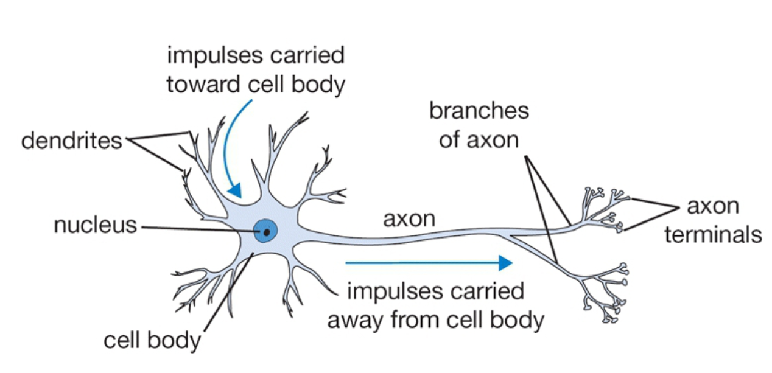
Deep learning uses neural networks
http://cs231n.github.io/neural-networks-1/

Slide 6
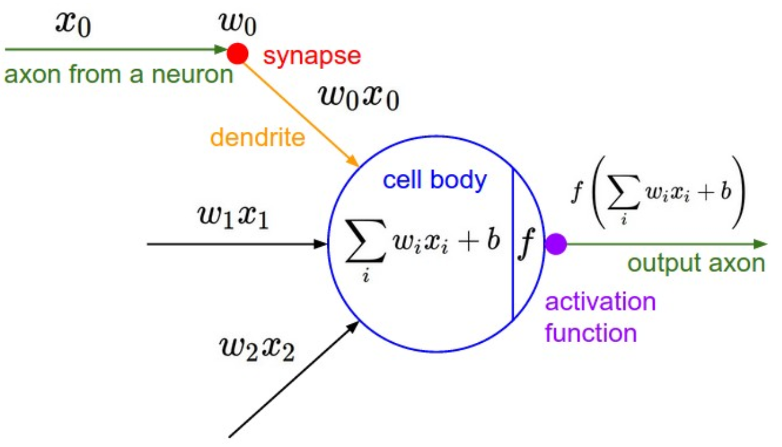
McCulloch-Pitts Neuron
http://cs231n.github.io/neural-networks-1/

Slide 7
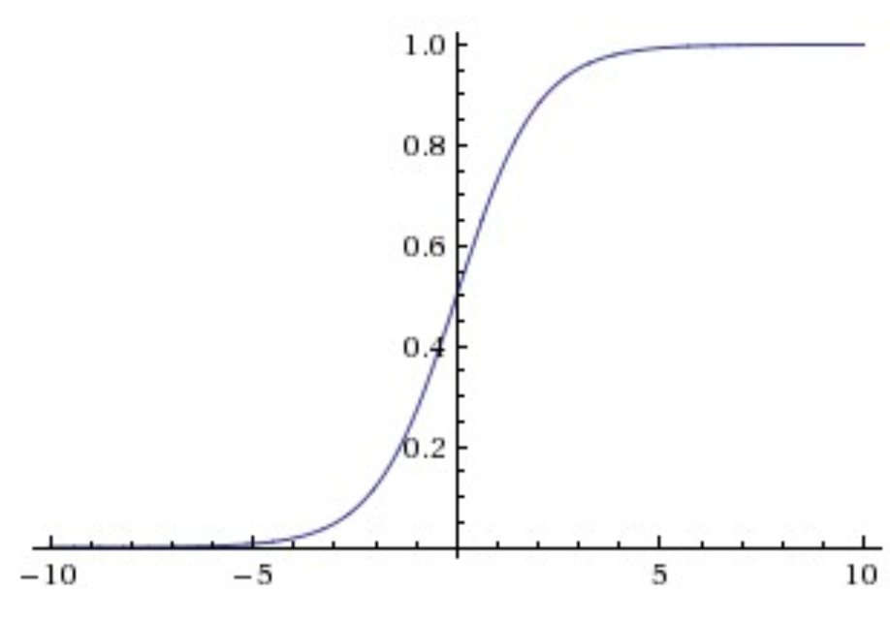
Activation function is nonlinear
http://cs231n.github.io/neural-networks-1/

Slide 8
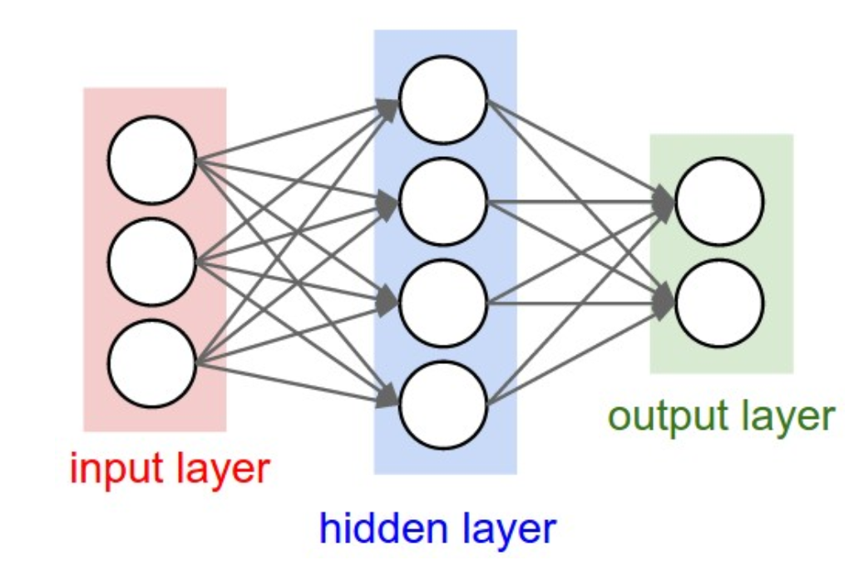
The “Perceptron” Each circle represents a neuron
http://cs231n.github.io/neural-networks-1/

Slide 9
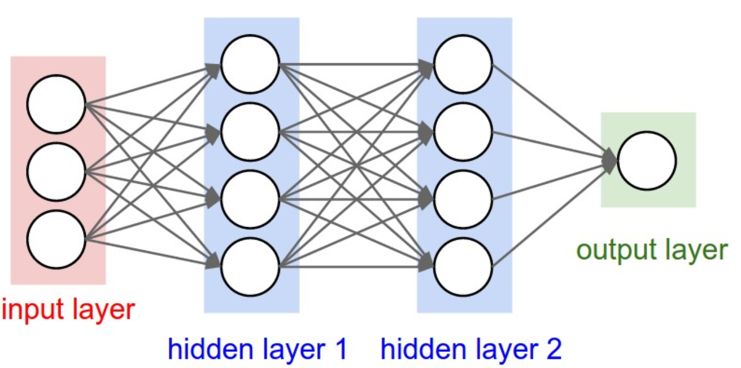
Mult-Layer Perceptron Technically a deep neural network (DNN)
http://cs231n.github.io/neural-networks-1/

Slide 10
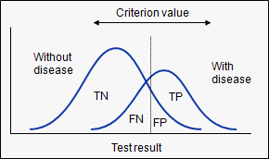
Area Under Curve (AUC)
A measure of how well a parameter can distinguish between two diagnostic groups (diseased/normal)
The closer to 1, the better
https://www.medcalc.org/manual/roc-curves.php

Slide 11
A few recent medical applications
Skin cancer screening
Diabetic retinopathy
Medication adherence
Fogel, Alexander L., and Joseph C. Kvedar. "Artificial intelligence powers digital medicine." npj Digital Medicine 1.1 (2018): 5

Slide 12
Skin cancer screening
The most common type of cancer
5.4 million new cases and 10,000 deaths in US each year
Training dataset had hundreds of thousands of images
DNN achieved AUC between .91 and .96
Fogel, Alexander L., and Joseph C. Kvedar. "Artificial intelligence powers digital medicine." npj Digital Medicine 1.1 (2018): 5

Slide 13
Diabetic retinopathy
Diabetes affects 29.1 million Americans
Another 86 million Americans have pre-diabetes
28.5% of U.S. diabetics have diabetic retinopathy (can lead to blindness)
Screening involves a dilated eye exam 1–2 times annually, with referral to an ophthalmologist
DNN trained with 128,175 images previously evaluated by a panel of 54 board-certified U.S. ophthalmologists and senior ophthalmology residents
AUC of 0.97–0.99 for detecting referable diabetic retinopathy
Fogel, Alexander L., and Joseph C. Kvedar. "Artificial intelligence powers digital medicine." npj Digital Medicine 1.1 (2018): 5

Slide 14
Medication adherence
Medication nonadherence contributes to 125,000 deaths accounts for more than $100 billion in healthcare costs each year
Used a DNN smartphone’s camera to visually identify the patient, the drug and confirm ingestion
Authors found that adherence was 100% in the intervention group compared with 50% in the control group
Fogel, Alexander L., and Joseph C. Kvedar. "Artificial intelligence powers digital medicine." npj Digital Medicine 1.1 (2018): 5

Slide 15
Position: Physician augmentation with AI/ML
Think of AI techniques as ways to reduce or eliminate mundane tasks
If a problem does not seem routine or mundane to you, it will most likely not be replaced with AI soon
Not guaranteed – AI advances and implications are difficult to predict
AI requires data
Preferably with labels
The more the better
The “cleaner” the better
Data is gold
Current AI “applications” papers use basic AI techniques applied to new problems
Need collaboration between medical and AI researchers

Slide 16
Plan
Introduction (today)
Convolutional neural networks (tomorrow)
Data processing, storage, and visualization
Regression
Classification
Segmentation
Analysis of DNNs

Slide 17
Introduction to Python and Google Colaboratory
Download files from https://gitlab.erc.monash.edu.au/andrease/Python4Maths/tree/master/Intro-to-Python
Go to http://colab.research.google.com
From the downloaded files, upload 01.ipynb

Slide 18
Tools for deep learning
Academic and industry has focused on Python language
Tensorflow is a Python deep learning framework from Google
Focused on performance in the beginning, now useability
PyTorch is a Python deep learning framework from Facebook
Focused on useability in the beginning, now performance

Slide 19
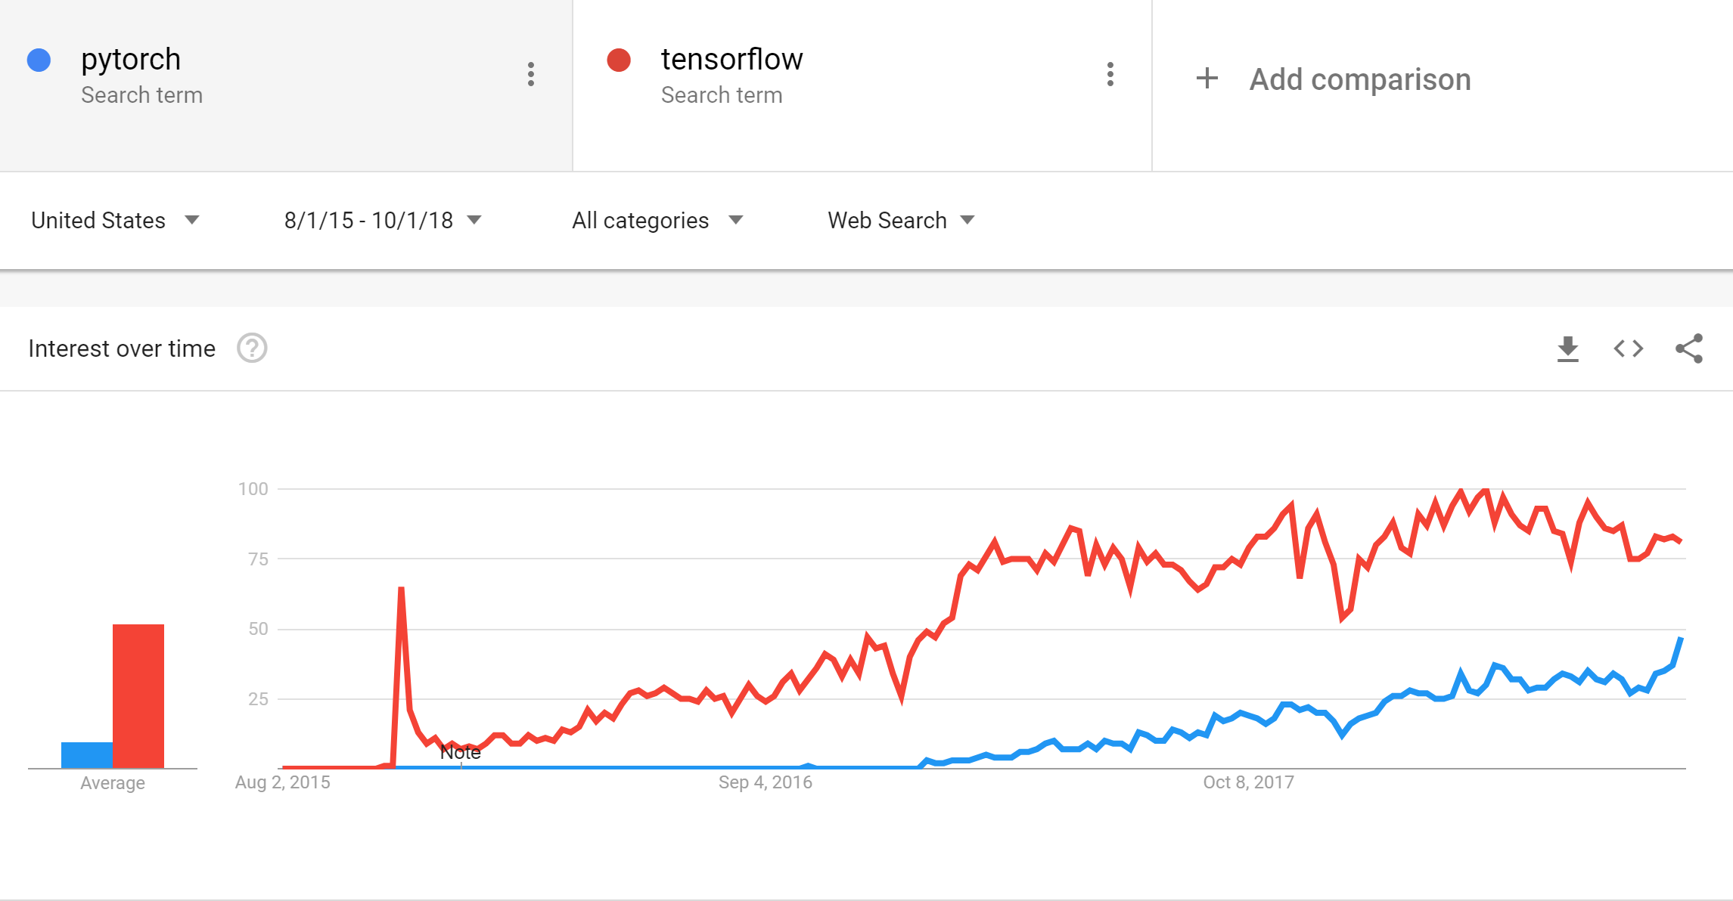

Slide 20
Training our first neural network
Upload PyTorch-CIFAR-10.ipynb

